Slide 1

Updates
Michelle Nienhius, MPH
Manager, Division of Prevention and Intervention Services
May 4, 2023
Notes:
Custom DAODAS color codes is : Red-0
Green-131
Blue-139

Slide 2
Topics Addressed:
Synar Study Updates
STEP/TEP/PREP
AET Updates
JPK/Embrace Recovery Campaign Updates
SOR/Naloxone Saturation Plan
FY24 Primary Prevention SAPT BG Set Aside Formula Updates and Upcoming Contracts
Training/Resources

Slide 3
SYNAR and STEP Program Overview
Counties can earn STEP points for some or all of the following efforts:
• Conducting tobacco compliance checks,
• Reporting new tobacco outlets and cleaning their list frame,
• Merchant Education,
• Tobacco Education Program,
• Point-of-Sale Taskforce development,
• Merchant Pledge(s),
• Establishing multi-jurisdictional law enforcement agreements around tobacco.
Please use the following designated STEP email address to ask DAODAS questions regarding STEP: daodas.stepprogram@daodas.sc.gov
Additionally, all templates, forms, and the new STEP Cover Sheet are on the SC Documents webpage: Search STEP
Submit by Monday, June 5, 2023 for points to be counted this fiscal year.

Slide 4
Tobacco Education Program (TEP)
Statewide committee continues to meet to update the curriculum
Utilizing the Stanford ToolKit to update the curriculum
New fidelity checklist and other materials will be developed by the committee following the training
Goal is to have curriculum updated and ready to use in August for upcoming FY

Slide 5
PREP Reminders
Revisions have been made to the PREP curriculum
All materials are on DAODAS website: https://www.daodas.sc.gov/services/prevention/merchant-initiatives/
PREP Training Materials- this is a password protected site
Password will be provided via email once staff members complete TOT
TOT training on Relias: The video can be found under the following title and individuals can self-enroll South Carolina Palmetto Retailers Education Program Training of Trainers 2022 (PREP TOT)
Please use the new fillable forms-all names and addresses should be typed into the new forms-handwriting is difficult to read and postage is being wasted when cards are returned to the agency.

Slide 6
AET Updates
Social media calendar for OOTH was sent out-hope this has been helpful
Printed materials for OOTH were delivered
AET Coordinator’s Meeting scheduled for May 23rd (in-person)- location to be determined
AET Coordinator Meetings for FY24 will be held in the months of July, September, November, January, March and May
Discussing a possible training and/or training of trainers during the summer for AET training courses
Social media calendar for back-to-school/football and tailgating

Slide 7
SYNAR Study Updates
The study timeframe for regions 1 and 4: March 1, 2023 – May 12, 2023.
  Region 1 and 4 are March 1, 2023– May 12,2023. If you are requesting an extension due to COVID, you must submit request in writing to DAODAS (prevention@daodas.sc.gov) by May 6, 2023. Extensions will be granted for the study to be conducted by May 20, 2023. Paperwork must be mailed (postmarked) to DAODAS by June 3, 2023.
Synar Manual on SC Documents website: https://ncweb.pire.org/scdocuments/

Slide 8
JPK and Embrace Recovery Campaign Updates
Updating the “Embrace Recovery” PSA with unused scenes that were previously recorded
Creating additional “1,2 Breathe” content for social media aimed at young adults
Creating additional social media content through animated ads for “Hidden Dangers” campaign
Developing new creative for the JPK campaign- “Conversations”
Continuing outreach events at local colleges, libraries, community centers, etc.

Slide 9
Naloxone saturation plan-Requirement of new SOR Grant
Saturation calculated using the protocol from the Maryland state:
  Formula: Target saturation = Deaths attributed to opioid overdose in target area *20
  Areas defined in terms of SC counties
  CY2020 the total number of overdose deaths related to opioids= 1,400
  Total target distribution for SC = 28,000 naloxone kits (1,400 X 20)

Slide 10
ODMAP: Overview
Overdose Detection Mapping Application Program
  National mapping application for participating organizations sponsored by Washington Baltimore HIDTA
Goals
  Provide near real-time surveillance of known or suspected overdose incidence across the United States and its territories
  Support public safety and public health efforts to collaborate and mobilize immediate responses to a sudden increase or spike in overdose incidents
  Slides from webinar provided by Emma Zawacki, DAODAS 3/21/2023

Slide 11
ODMAP: Data Entry
State Bureau of EMS (beginning June 1, 2021) provides data on non-fatal suspected overdoses across the state directly, typically within 24 to 72 hours of an incident
Local law enforcement, EMS, and coroners support entry of additional data such as fatal overdoses as needed
  Dependent on regional participation
  Slides from webinar provided by Emma Zawacki, DAODAS 3/21/2023

Slide 12
ODMAP: Disclaimer and Limitations
The data included is preliminary information for informational purposes only.
The data include suspected counts of overdoses and substances reported at the scene by responding personnel, and such information has not yet been verified by additional means (e.g., lab testing).
  The reported information (counts, number of fatalities, and substances used) may vary from official mortality and police reports due to the preliminary nature of ODMAP.
This information is considered controlled unclassified information to be released only to authorized personnel who have a need to know in the performance of public health functions.
The data does not include personally identifiable information nor personal health information.
All locations are geocoded in a restricted manner such that one cannot determine precise locations.
Slides from webinar provided by Emma Zawacki, DAODAS 3/21/2023

Slide 13
Sample Protocol: GMS Reporting
DAODAS County
2/1/2023-2/28/2023
15 events
Majority of events occurred in Southwest Area of the region with some clusters near the park and hotel
Opioids were listed in half of the cases
Events mostly occurred Friday and Saturday late evenings
Slides from webinar provided by Emma Zawacki, DAODAS 3/21/2023

Slide 14
Sample Protocol: GMS Reporting
DAODAS County
2/1/2023-2/28/2023
15 events
Majority of events occurred in Southwest Area of the region with some clusters near the park and hotel
Opioids were listed in half of the cases
Events mostly occurred Friday and Saturday late evenings
Important to know location, time frame and burden. If spike or short time frame, this may be more of a rapid response type of event
Location to known events. ODMAP may not allow zooming to provide detail of business name, but provide context (hotel) if you are familiar with area
Optional: you may not have this information, but it can help if available
Notes:
If it’s red, it’s required. Remember there are 4 events per quarter and within 30 days of ODMAP analysis, so be sure to have an internal timeline and process to fulfill these obligations
The strategy should be to indicate to DAODAS on their Narcan event forms, that their outreach event was in an area that showed as hotspot on ODMAP during a specific week. Ask them to try to be as specific as possible when making notes on event forms. For example: use names of a community such as the Sandhill community, near the park rather than saying in the South East area if you have those details.

Slide 15
Resources
DHEC ODMAP Trainer
  Assists with ODMAP usage and registration
  Danika Bass – bassdl@dhec.sc.gov
  Be on the look out for a training series anticipated late summer to refresh your skills
HIDTA site
  https://www.hidtaprogram.org/odmap.php
  Includes program contact and link to official resources
    Ex. Official ODMAP YouTube account with training videos
Other state resources
  Searching ODMAP will provide results of other state government sites (.gov) with information on how they use the program to track data and plan events/resource allocation
  Slides from webinar provided by Emma Zawacki, DAODAS 3/21/2023

Slide 16
  Primary Prevention Funding Formula
A standard formula for the distribution of the SABG primary prevention set-aside funding was adopted by DAODAS in July 2013 and went into effect with state Fiscal Year 2014 (FY14).
Incorporating input from the Executive Committee of Behavioral Health Services Association of South Carolina Inc., the adopted allocation method was developed by DAODAS to achieve a base funding amount for each county, along with a population-adjusted figure to ensure that prevention services are provided equitably across the state.
Due to an overall increase in the allocation for South Carolina for the Substance Abuse Prevention and Treatment Block Grant (SAPT BG), from $23,934,835 in FY23 to $26,137,986 in FY24, the total for the 20% set aside for primary prevention also increased from $5,265,666 in FY23 to $5,619,667 in FY24.
FY24 Formula
1. The “floor” (base) will be increased to $70,000 for each county authority. (Changed from $60,000)
2. County authorities that serve more than one county receive an additional $15,000 per county. (remains same)
3. Revised population-based data from the 2020 Census. The percentages did not change from Fiscal Year 2023. These range from 0.40% to 13.87%. The funding range changed from $7,223.66 to $249,152.33 due to an increase in the funding allotted to this part of the funding formula and the population estimates. At a minimum, population adjustments will be revised every five years. (Increased from FY23)

Slide 17
Primary Prevention Funding Formula
Amounts for AET did not change from FY23 (COVID-19 funding ends March, 2023 and at this time there is not any additional funding to allocate from ARPA)
Based on the funding formula, all agencies received an increase between $10,000-$11,965.00
DAODAS Finance will be sending out award allocations to complete the FY24 Prevention Application by Friday, February 10th.
Questions- email Sharon Peterson (speterson@daodas.sc.gov ) and Michelle Nienhius (mnienhius@daodas.sc.gov )

Slide 18
FY 24 Funding and Compliance Contract and Prevention Services Manual
Executive Director should provide a copy of the contract to the Prevention Director when they receive it in the upcoming months.
Prevention Services Manual is currently being updated for FY24 and the revised copy will be placed on the SC Documents website (https://ncweb.pire.org/) when the updates are completed
Reminders:
All full- and part-time employees delivering prevention services shall have a period of 36 months from their permanent date of hire to obtain prevention certification through the South Carolina Association of Prevention Professionals and Advocates. The certification timeline allows agencies to include a probationary period, not to exceed six months, if they desire.
All prevention professionals must have a training plan for obtaining and maintaining certification. This plan must be updated annually.
All prevention staff shall attend the Substance Abuse Prevention Specialist Training (SAPST) within two years of their hire date.

Slide 19
A key element for ensuring that the highest-quality prevention services are provided to all South Carolina citizens, organizations funded by DAODAS through the Substance Abuse Prevention and Treatment Block Grant (SABG) shall obtain and maintain national accreditation by either the Joint Commission or CARF International for their primary prevention programs that target children, youth/adolescents, and adults.
Each agency shall have at least one representative attend the Prevention Quarterly Meetings that are held by DAODAS on the first Thursday (unless notified of a change by DAODAS) of the following months: August, November, February, and May.
All prevention personnel funded through the SABG Primary Prevention Set-aside (regardless of percentage of salary funded) are required to enter direct and indirect service hours into the web-based reporting system each month. The percentage of staff time entered is expected to be direct/indirect service time in order to accomplish each agency’s goals/objectives that have been set for primary prevention. Each agency is required to complete the Prevention Staffing Capacity Plan and send to DAODAS by the end of July each year. It is the responsibility of the agency to send to DAODAS a revised Prevention Staffing Capacity Plan if there are any personnel changes, staff funding changes, etc., that occur throughout the fiscal year.

Slide 20
Each prevention staff member funded under the SABG Primary Prevention Set-aside shall enter data by the end of each week. However, minimal standards for timeliness are that all data must be entered monthly, with reporting complete by the eighth working day of the following month. If there is a need for an extension for data entry, a request shall be made by the agency to the DAODAS Manager of Prevention and Intervention Services at least five business days in advance of the deadline.
Minimum standards for accuracy of monthly data entered into the web-based reporting system are as follows:
a) correct application of service categories (direct vs. indirect) and populations served;
b) required monthly documentation of service hours for any organizational member or volunteer who is providing prevention services;
c) Demographics of people served in prevention services as required for federal reporting;
d) appropriate documentation of funding and reporting to ensure compliance.

Slide 21
Prevention providers are required to use the DAODAS Standard Survey (provided separately) as an evaluation tool for any multi-session education program aimed at youth ages 10 to 20. This applies to research-based and non-research-based programs. Program exceptions for the use of the DAODAS Standard Survey are noted and defined in the South Carolina Prevention Evaluation Handbook. There is a paper and online version of the survey available.
**These are just a few highlights from the Manual, please read the entire document and contact DAODAS with any questions.
New Staffing and Capacity plan will be sent out by first of June and should be uploaded in GMS (TX project) by end of July.

Slide 22

Fentanyl Awareness Day-May 9th
National Fentanyl Awareness Day aims to amplify nationwide efforts to increase awareness and decrease demand for fentanyl, which is a highly addictive synthetic opioid that continues to drive the overdose epidemic.
Download graphics and visuals to post on your social platform(s) using the #NationalFentanylAwarenessDay hashtag to increase knowledge about the issue.
Download a toolkit that provides: resources to share on social media, messaging guidelines, and draft email outreach.
https://www.fentanylawarenessday.org
https://www.dea.gov/fentanylawareness

Slide 23

CADCA Mid-Year
July 16-20, 2023-Gaylord Texan Hotel & Convention Center-Grapevine, Texas
https://www.cadca.org/myti2023
What does Mid-Year Offer?
Training from top experts in the field
Information, tools, and strategies to take your prevention work to the next level
The latest science, news, and trends on substance misuse issues
The opportunity to network with thousands of advocates passionate about prevention
Specialized youth leadership training

Slide 24

The purpose of the NPN Conference is to highlight the latest research in the substance use prevention field. It provides a forum for prevention professionals, coalition leaders, researchers, and federal partners to share research, best practices and promising evaluation results for the purpose of integrating research into prevention practice.
NPN Conference 2023
August 15 - 17, 2023
Registration Opens: 5/8/2023
Sheraton Birmingham
Birmingham, Alabama
http://npnconference.org

Slide 25


2023 NLLEA Annual Conference
October 9-11, 2023
Call for Workshop Proposals
Proposal Submission Guidelines
Deadline January 31, 2023
https://www.nllea.org/home

Slide 26

NOVEMBER 8TH & NOVEMBER 9TH, 2023
Historic Charleston, South Carolina
The 2nd Annual National Emerging Drug Trends Conference will be held on November 8th and 9th, 2023 in historic Charleston, South Carolina. The conference is an exclusive drug education and enforcement conference highlighting an array of superior speakers with expert knowledge.
REGISTRATION
Early Registration: Will open in January of 2023!
https://www.emergingdrugtrends.com/about
SAVE
T H E
DATE

Slide 27
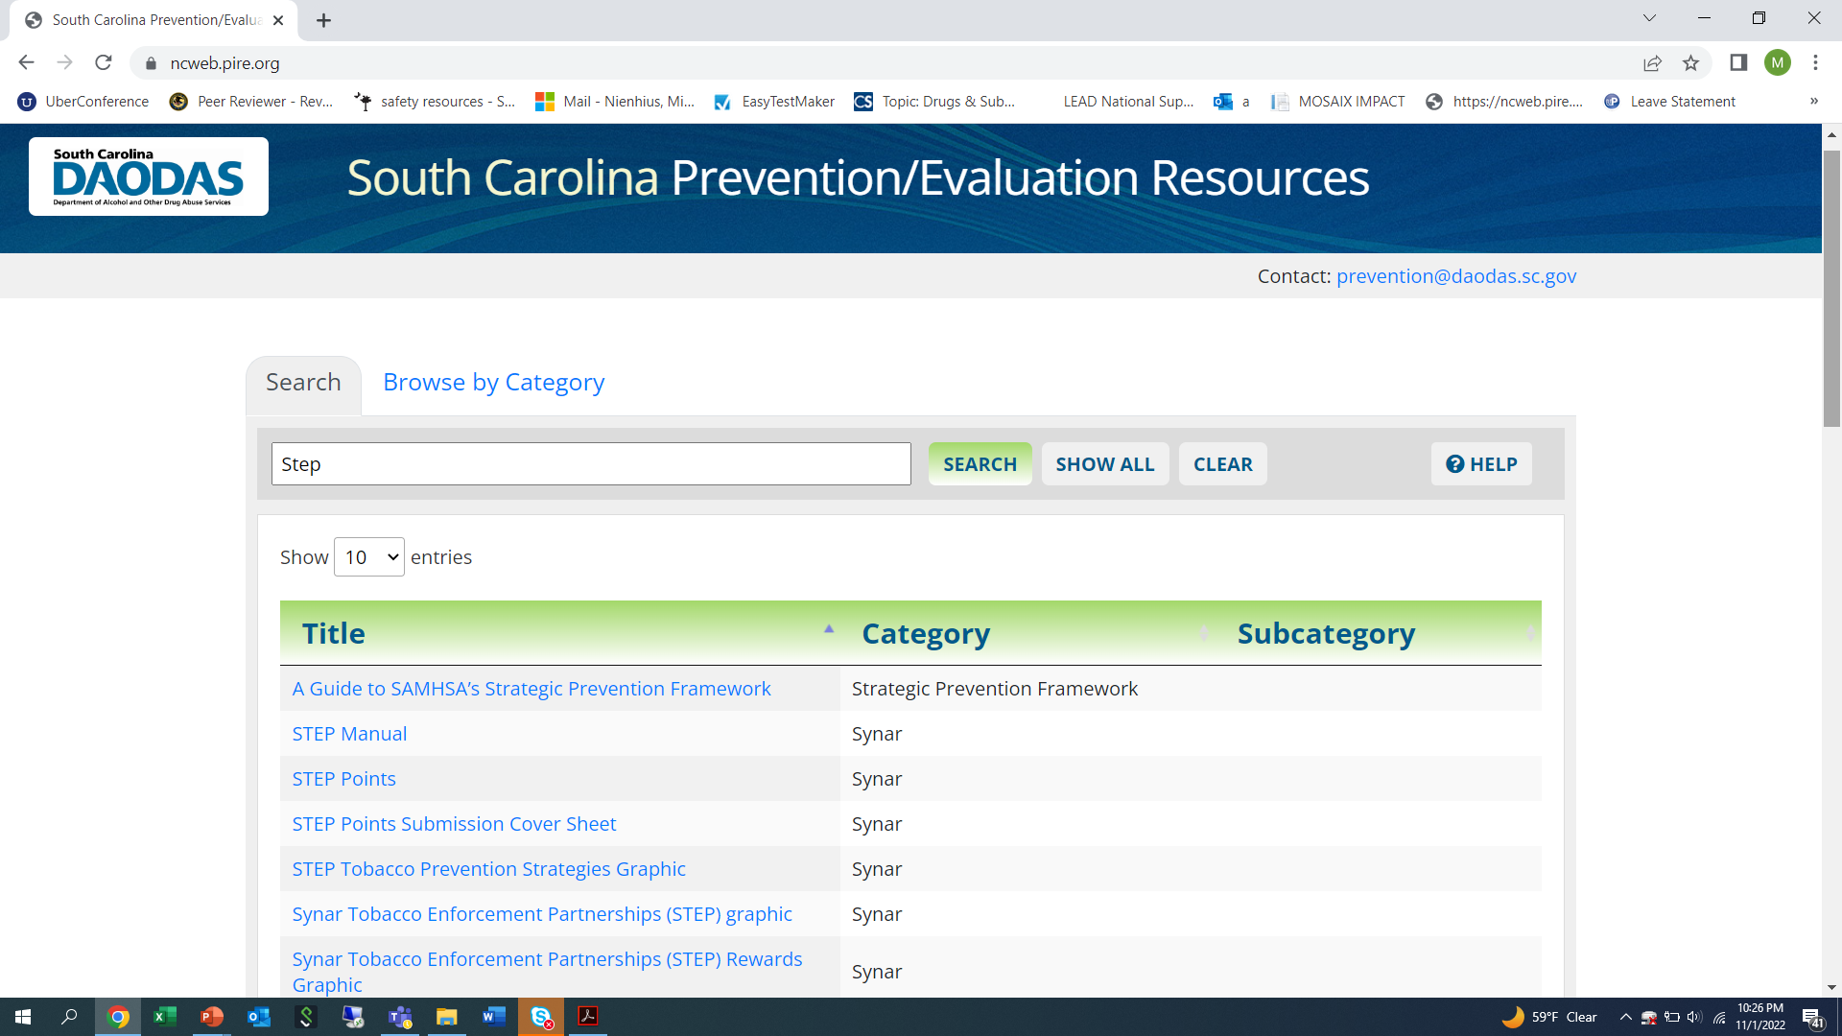

Slide 28

1801 Main Street, 4th Floor • Columbia, South Carolina 29201
telephone: 803-896-5555 • fax: 803-896-5558
www.daodas.sc.gov
Notes:
Final Slide

